Slide 1

"Deploying application using CI/CD pipeline"
Presented by Payal Navneet Gurave
Title
Finance Data Processing and Access Control System

Slide 2
Project Overview
Secure web-based financial dashboard
Designed for organizations with multiple user roles
Manages income, expenses, and financial records in one place
Provides analytics and insights through dashboard
Supports three roles: Viewer, Analyst, Admin
Strong API-level security prevents unauthorized access
Built using React ( frontend) and Node.js/Express (backend) MongoDB
with

Slide 3

Objectives
Security C Access Control
Data Management
Performance C User Experience
System Security

Slide 4
Application Flow
Frontend (React)
User opens the application and logs in
User interacts with dashboard and financial records
Sends API requests using Axios
JWT token is attached with every request
Backend (Node.js/Express)
Receives API requests from frontend
Verifies JWT (Authentication)
Checks user role (Authorization)
Processes request through controller & service layer
Applies business logic
Database (MongoDB)
Stores user and financial data
Handles data operations (create, read, update, delete)
Sends data back to backend
CI/CD (Deployment Flow)
Code pushed to GitHub
(Future) GitHub Actions for automation
Deployment on Railway
Ensures continuous updates and scalability

Slide 5
Tech Stack
Frontend
Backend
Database
Security
Tools
React Vite Tailwind Recharts Axios
Node.js, Express.js
MongoDB Mongoose
JWT
Bcryptjs
Rate Limiting
GitHub Railway

Slide 6
System Flow
User Interaction
Authentication Request Flow
Backend Processing
Database Interaction
Response Output

Slide 7


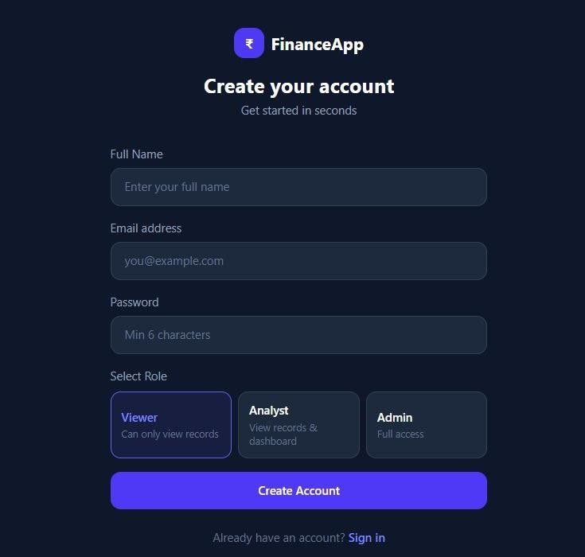
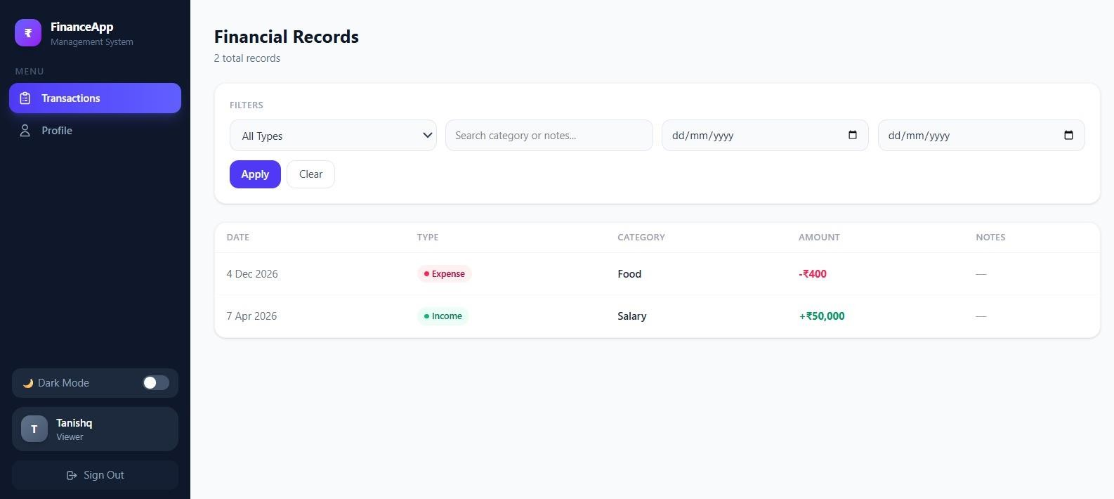
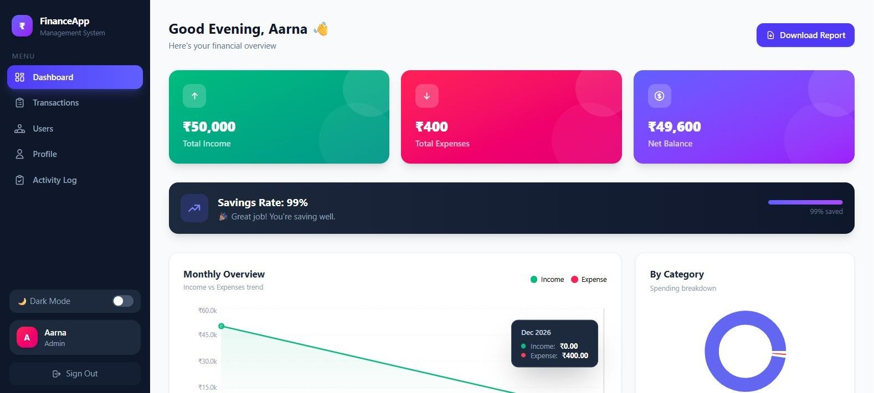
Frontend

Slide 8
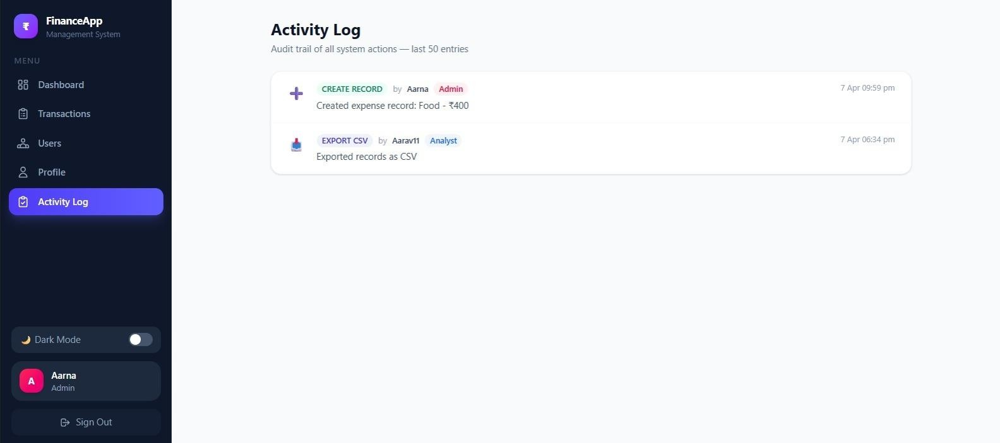
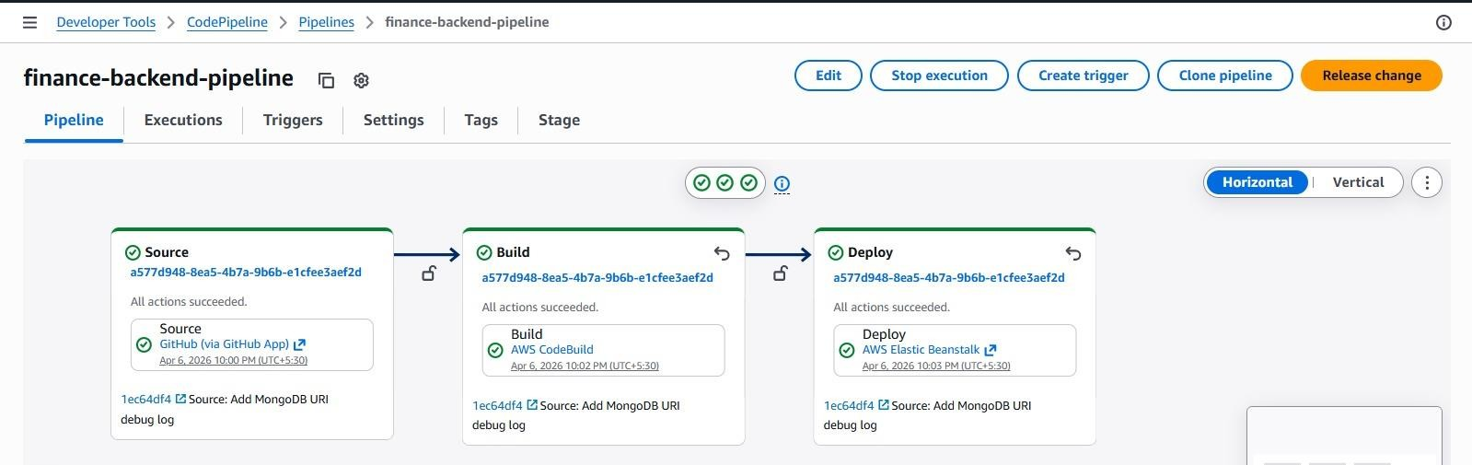
Backend(CI/CD)

Slide 9
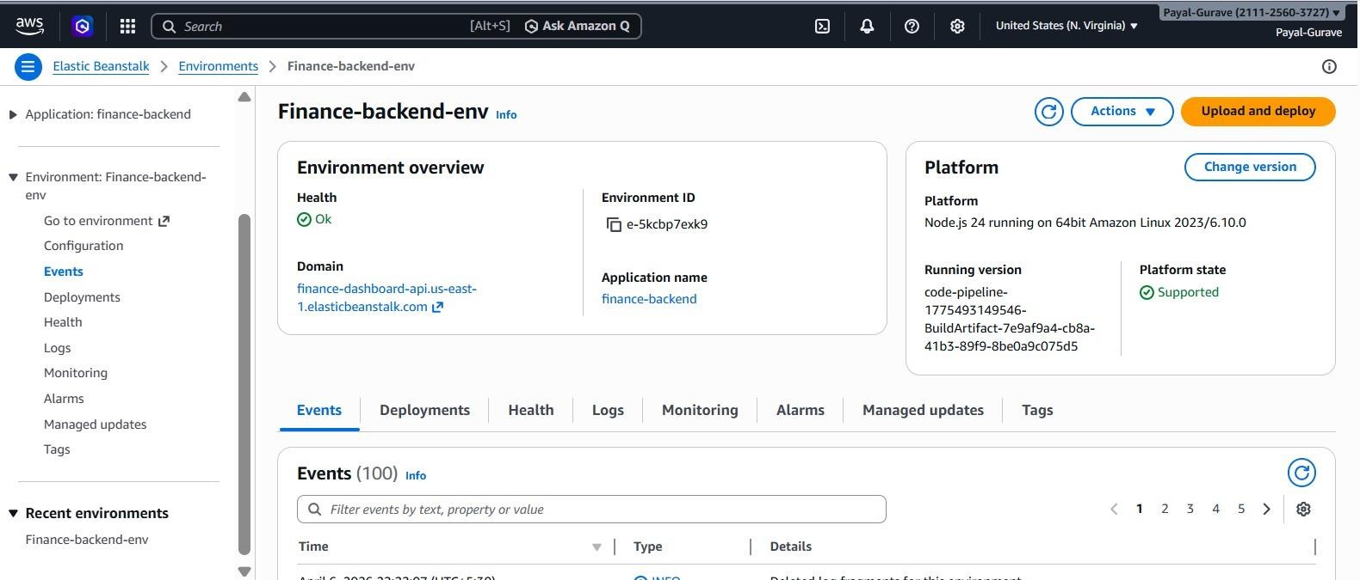
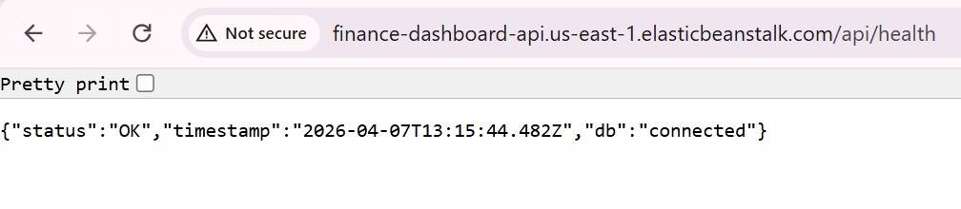

Slide 10
Thank You

